Slide 1
Apoyo homework 4 Pandas

Slide 2
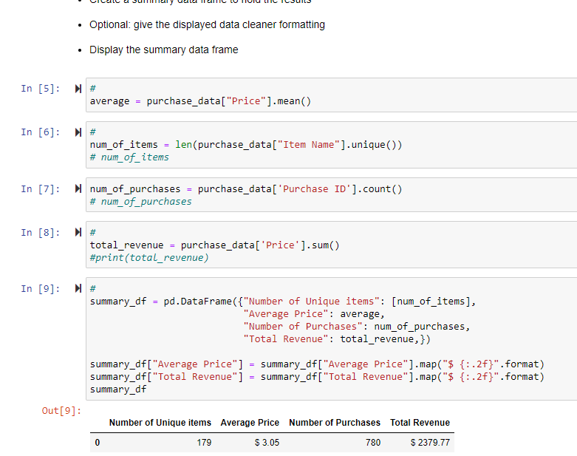
summary

Slide 3
